Slide 1

Using NLP to Flag Political Reddit Posts
Jack Olson

Slide 2
Summary
Part 1
Why Reddit Moderation Matters
Part 2
Modeling to Catch Political Posts
Part 3
Results

Slide 3
Why reddit moderation matters
Part 1

Slide 4

What is reddit?
Reddit.com is an aggregation website for a wide variety of forums, called subreddits
One of the most popular aspects of Reddit is its upvote/downvote system
This voting system allows the community to self-moderate

Slide 5
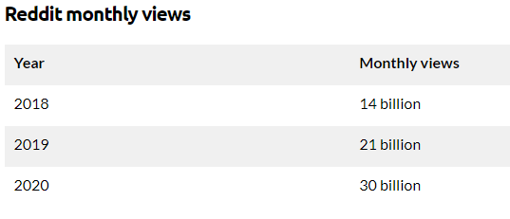
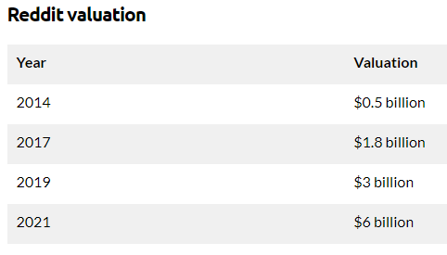
Reddit’s Growth
Source

Slide 6
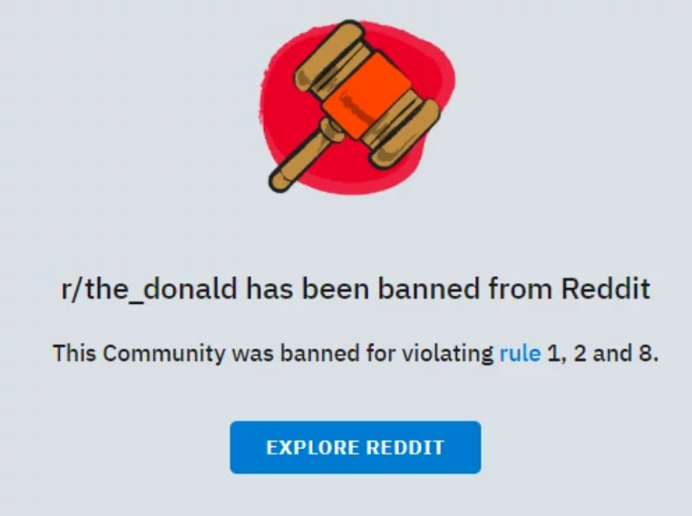
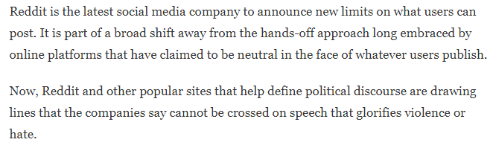
Why Political posts need more moderation
Source: npr.org

Slide 7
Modeling to Catch political posts
Part 2

Slide 8
NLP using Post titles
Count Words in Post Titles
1
Measure How Common Words are in Each Subreddit
2
Predict Where a Post Originated Based On Title
3
I collected 3000 recent posts from both r/AskReddit and r/politics
I built three models, all of them can be simplified to the three steps above

Slide 9
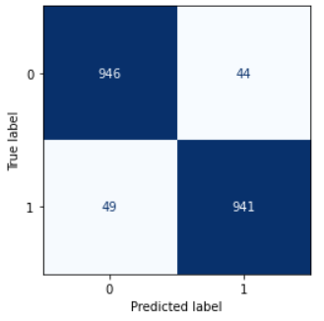

“Flagging” Political Askreddit posts
0 = AskReddit
1 = Politics
We only care about the AskReddit posts, which is the top half of the matrix
In this case, the highlighted number is the amount of flagged posts

Slide 10
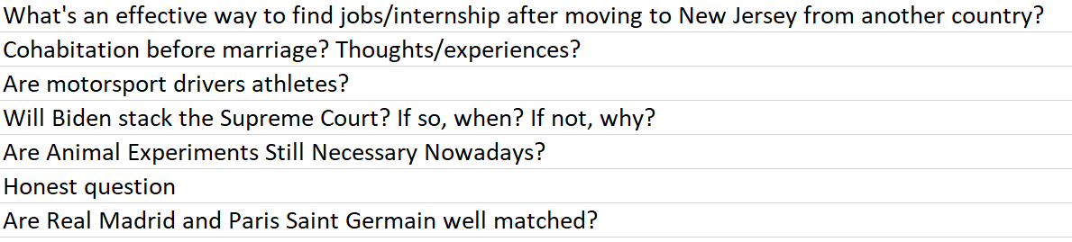
Moderator reviews flagged posts for political content
Below is an excerpt from the flagged posts of model #3
The moderator would read through these flagged posts to look for political content
The only way to know if a flagged post is truly political is to read them

Slide 11
Results
Part 3

Slide 12
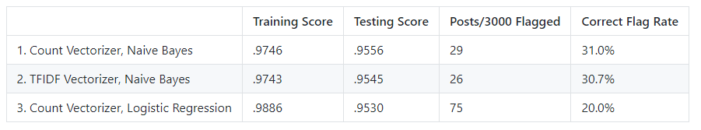
Modeling results
Model #1 had the highest testing score, meaning it was the best for predicting where a post originated
Model #1 had the highest correct flag rate. Of the 29 posts flagged, 31% were actually political
Model #3 flagged the most posts. Its correct flag rate was thee lowest of the three

Slide 13
Successes & Areas for Improvement
Successes
Areas for improvement
High testing scores. All three models were good at predicting where a post originated
Only run posts with 50+ upvotes through the models. Focus on posts likely to get visibility
Sort output list of flagged posts by the probability it is political
Put more features into the model other than just the titles
Find a scalable way to know the true number of political askreddit posts

Slide 14

Conclusion
Reddit’s need for dedicated moderation has grown. Political posts need special attention
Our goal was to identify AskReddit posts with political content
These models are one tool moderators could use to flag and monitor political posts

